Slide 1
Mobile and Web Multimedia
CT08-3-3 & Version VC1
Mobile Security

Slide 2
Topic & Structure of The Lesson
Introduction
Infrastructure
M-Commerce Applications
Mobile Payment
Limitations
Security in M-Commerce

Slide 3
Learning Outcomes
At the end of this topic, You should be able to:
Examine the challenges involved in mobile security.
Identify issues and constraints for mobile security.

Slide 4
Key Terms You Must Be Able To Use
If you have mastered this topic, you should be able to use the following terms correctly in your assignments and exams:
Mobile Security
Risks

Slide 5
Introduction
Mobile commerce (m-commerce,
m-business)—any e-commerce done in a wireless environment, especially via the Internet
Can be done via the Internet, private communication lines, smart cards, etc.
Creates opportunity to deliver new services to existing customers and to attract new ones

Slide 6
Mobile Commerce: Overview
Mobile commerce (m-commerce,
m-business)—any e-commerce done in a wireless environment, especially via the Internet
Can be done via the Internet, private communication lines, smart cards, etc.
Creates opportunity to deliver new services to existing customers and to attract new ones

Slide 7
Mobile commerce from the Customer‘s point of view
The customer wants to access information, goods and services any time and in any place on his mobile device.
He can use his mobile device to purchase tickets for events or public transport, pay for parking, download content and even order books and CDs.
He should be offered appropriate payment methods. They can range from secure mobile micropayment to service subscriptions.

Slide 8
Mobile commerce from the Provider‘s point of view
The future development of the mobile telecommunication sector is heading more and more towards value-added services. Analysts forecast that soon half of mobile operators‘ revenue will be earned through mobile commerce.
Consequently operators as well as third party providers will focus on value-added-services. To enable mobile services, providers with expertise on different sectors will have to cooperate.
Innovative service scenarios will be needed that meet the customer‘s expectations and business models that satisfy all partners involved.

Slide 9
M-Commerce Terminology
Generations
1G: 1979-1992 wireless technology
2G: current wireless technology; mainly accommodates text
2.5G: interim technology accommodates graphics
3G: 3rd generation technology (2001-2005) supports rich media (video clips)
4G: will provide faster multimedia display (2006-2010)

Slide 10
Terminology and Standards
GPS: Satellite-based Global Positioning System
PDA: Personal Digital Assistant—handheld wireless computer
SMS: Short Message Service
EMS: Enhanced Messaging Service
MMS: Multimedia Messaging Service
WAP: Wireless Application Protocol
Smartphones—Internet-enabled cell phones with attached applications

Slide 11
Attributes of M-Commerce and Its Economic Advantages
Mobility—users carry cell phones or other mobile devices
Broad reach—people can be reached at any time
Ubiquity—easier information access in real-time
Convenience—devices that store data and have Internet, intranet, extranet connections
Instant connectivity—easy and quick connection to Internet, intranets, other mobile devices, databases
Personalization—preparation of information for individual consumers
Localization of products and services—knowing where the user is located at any given time and match service to them

Slide 12
Outline
M-Commerce
Infrastructure
M-Commerce Applications
Mobile Payment
Limitations
Security in M-Commerce

Slide 13
Mobile Computing Infrastructure
Hardware
Cellular (mobile) phones
Attachable keyboard
PDAs
Interactive pagers
Other devices
Notebooks
Handhelds
Smartpads
Screenphones—a telephone equipped with color screen, keyboard, e-mail, and Internet capabilities
E-mail handhelds
Wirelined—connected by wires to a network

Slide 14
Mobile Computing Infrastructure (cont.)
Unseen infrastructure requirements
Suitably configured wireline or wireless WAN modem
Web server with wireless support
Application or database server
Large enterprise application server
GPS locator used to determine the location of mobile computing device carrier

Slide 15
Mobile Computing Infrastructure (cont.)
Software
Microbrowser
Mobile client operating system (OS)
Bluetooth—a chip technology and WPAN standard that enables voice and data communications between wireless devices over short-range radio frequency (RF)
Mobile application user interface
Back-end legacy application software
Application middleware
Wireless middleware

Slide 16
Mobile Computing Infrastructure (cont.)
Networks and access
Wireless transmission media
Microwave
Satellites
Radio
Infrared
Cellular radio technology
Wireless systems

Slide 17
Outline
M-Commerce Overview
Infrastructure
M-Commerce Applications
Mobile Payment
Limitations
Security in M-Commerce

Slide 18
Mobile Service Scenarios
Financial Services.
Entertainment.
Shopping.
Information Services.
Payment.
Advertising.
And more ...

Slide 19
Early content and applications have all been geared around information delivery but as time moves on the accent will be on revenue generation.
Entertainment
Music
Games
Graphics
Video
Pornography
Communications
Short Messaging
Multimedia Messaging
Unified Messaging
e-mail
Chatrooms
Video - conferencing
M- commerce
Transactions
Banking
Broking
Shopping
Auctions
Betting
Booking & reservations
Mobile wallet
Mobile purse
Information
News
City guides
Directory Services
Maps
Traffic and weather
Corporate information
Market data

Slide 20
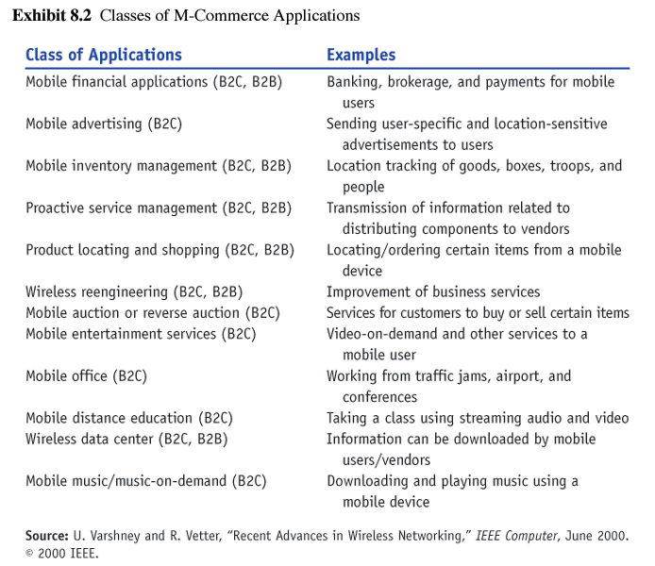
Classes of M-Commerce Applications

Slide 21
Mobile Application: Financial Tool
As mobile devices become more secure
Mobile banking
Bill payment services
M-brokerage services
Mobile money transfers
Mobile micropayments
Replace ATM’s and credit cards??

Slide 22
Financial Tool: Wireless Electronic Payment Systems
“transform mobile phones into secure, self-contained purchasing tools capable of instantly authorizing payments…”
Types:
Micropayments
Wireless wallets (m-wallet)
Bill payments

Slide 23
Examples
Swedish Postal Bank
Check Balances/Make Payments & Conduct some transactions
Dagens Industri
Receive Financial Data and Trade on Stockholm Exchange
Citibank
Access balances, pay bills & transfer funds using SMS

Slide 24
Mobile Applications : Marketing, Advertising, And Customer Service
Shopping from Wireless Devices
Have access to services similar to those of wireline shoppers
Shopping carts
Price comparisons
Order status
Future
Will be able to view and purchase products using handheld mobile devices

Slide 25
Mobile Applications : Marketing, Advertising, And Customer Service
Targeted Advertising
Using demographic information can personalize wireless services (barnesandnoble.com)
Knowing users’ preferences and surfing habits marketers can send:
User-specific advertising messages
Location-specific advertising messages

Slide 26
Mobile Applications : Marketing, Advertising, And Customer Service
CRM applications
MobileCRM
Comparison shopping using Internet capable phones
Voice Portals
Enhanced customer service improved access to data for employees

Slide 27
Mobile Portals
“A customer interaction channel that aggregates content and services for mobile users.”
Charge per time for service or subscription based
Example: I-Mode in Japan
Mobile corporate portal
Serves corporations customers and suppliers

Slide 28
Mobile Intrabusiness and Enterprise Applications
Support of Mobile Employees
by 2005 25% of all workers could be mobile employees
sales people in the field, traveling executives, telecommuters, consultants working on-site, repair or installation employees
need same corporate data as those working inside company’s offices
solution: wireless devices
wearable devices: cameras, screen, keyboard, touch-panel display

Slide 29
Mobile B2B and Supply Chain Applications
“mobile computing solutions enable organizations to respond faster to supply chain disruptions by proactively adjusting plans or shifting resources related to critical supply chain events as they occur.”
accurate and timely information
opportunity to collaborate along supply chain
must integrate mobile devices into information exchanges
example: “telemetry” integration of wireless communications, vehicle monitoring systems, and vehicle location devices
leads to reduced overhead and faster service responsiveness (vending machines)

Slide 30
Applications of Mobile Devices for Consumers/Industries
Personal Service Applications
example airport
Mobile Gaming and Gambling
Mobile Entertainment
music and video
Hotels
Intelligent Homes and Appliances
Wireless Telemedicine
Other Services for Consumers

Slide 31
Outline
M-Commerce Overview
Infrastructure
M-Commerce Applications
Mobile Payment
Limitations
Security in M-Commerce

Slide 32
Mobile Payment for M-Commerce
Mobile Payment can be offered as a stand-alone service.
Mobile Payment could also be an important enabling service for other m-commerce services (e.g. mobile ticketing, shopping, gambling…) :
It could improve user acceptance by making the services more secure and user-friendly.
In many cases offering mobile payment methods is the only chance the service providers have to gain revenue from an m-commerce service.

Slide 33
Mobile Payment (cont.)
the consumer must be informed of:
what is being bought, and
how much to pay
options to pay;
the payment must be made
payments must be traceable.

Slide 34
Mobile Payment (cont.)
Customer requirements:
a larger selection of merchants with whom they can trade
a more consistent payment interface when making the purchase with multiple payment schemes, like:
Credit Card payment
Bank Account/Debit Card Payment
Merchant benefits:
brands to offer a wider variety of payment
Easy-to-use payment interface development
Bank and financial institution benefits
to offer a consistent payment interface to consumer and merchants

Slide 35


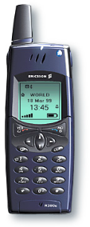


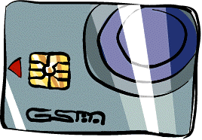
Payment via Internet Payment Provider
WAP GW/Proxy
Browsing (negotiation)
Merchant
MeP
GSM Security
SSL tunnel
User
SMS-C
IPP
Mobile Wallet
CC/Bank

Slide 36
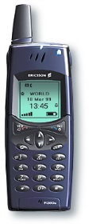

Payment via integrated Payment Server
WAP GW/Proxy
Browsing (negotiation)
Mobile Commerce
Server
Merchant
GSM Security
User
SSL tunnel
SMS-C
ISO8583 Based
CP
VPP IF
CC/Bank
Mobile Wallet
Voice PrePaid

Slide 37
Outline
M-Commerce Overview
Infrastructure
M-Commerce Applications
Mobile Payment
Limitations
Security in M-Commerce

Slide 38
Limitations of M-Commerce
Usability Problem
small size of mobile devices (screens, keyboards, etc)
limited storage capacity of devices
hard to browse sites
Technical Limitations
lack of a standardized security protocol
insufficient bandwidth
3G liscenses

Slide 39
Limitations of M-Commerce
Technical Limitations…
transmission and power consumption limitations
poor reception in tunnels and certain buildings
multipath interference, weather, and terrain problems and distance-limited connections
WAP Limitations
Speed
Cost
Accessibility

Slide 40
Limiting technological factors
Networks
Bandwidth
Interoperability
Cell Range
Roaming
Mobile Middleware
Standards
Distribution
Localisation
Upgrade of Network
Upgrade of Mobile
Devices
Precision
Security
Mobile Device
Network
Gateway
Mobile Devices
Battery
Memory
CPU
Display Size

Slide 41
Potential Health Hazards
Cellular radio frequecies = cancer?
No conclusive evidence yet
could allow for myriad of lawsuits
mobile devices may interfere with sensitive medical devices such as pacemakers

Slide 42
Outline
M-Commerce Overview
Infrastructure
M-Commerce Applications
Mobile Payment
Limitations
Security in M-Commerce

Slide 43
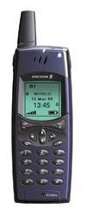
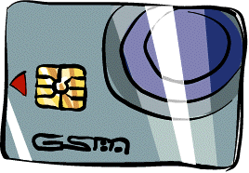



Security in M-Commerce: Environment
CA
Shopping
SAT GW
(SIM)
Mobile
Network
Mobile IP Service ProviderNetwork
Content
Aggregation
Internet
WAP1.1(+SIM where avail.)
WAP GW
Merchant
Mobile e-Commerce
Server
Bank (FI)
Mobile Bank
Security and
Payment
WAP1.2(WIM)
Operator centric model

Slide 44
WAP Architecture
Client
Web Server
WAP Gateway
WML
CGI
Scripts
etc.
WML Encoder
WML-Script
WSP/WTP
HTTP
WML Decks
with WML-Script
WMLScript
Compiler
WTAI
Protocol Adapters
Content
Etc.

Slide 45
Comparison between Internet and WAP technologies
Wireless Application Protocol
HTML
JavaScript
Wireless Application Environment (WAE)
Other Services and
Applications
Session Layer (WSP)
HTTP
Transaction Layer (WTP)
TLS - SSL
Security Layer (WTLS)
Transport Layer (WDP)
TCP/IP
UDP/IP
Bearers:
SMS
USSD
CSD
IS-136
CDMA
CDPD
PDC-P
Etc..

Slide 46
WAP Risks
WAP Gap
Claim: WTLS protects WAP as SSL protects HTTP
Problem: In the process of translating one protocol to another, information is decrypted and re-encrypted
Recall the WAP Architecture
Solution: Doing decryption/re-encryption in the same process on the WAP gateway
Wireless gateways as single point of failure

Slide 47
Platform Risks
Without a secure OS, achieving security on mobile devices is almost impossible
Learned lessons:
Memory protection of processes
Protected kernel rings
File access control
Authentication of principles to resources
Differentiated user and process privileges
Sandboxes for untrusted code
Biometric authentication

Slide 48
WMLScript
Scripting is heavily used for client-side processing to offload servers and reduce demand on bandwidth
Wireless Markup Language (WML) is the equivalent to HTML, but derived from XML
WMLScript is WAP’s equivalent to JavaScript
Derived from JavaScript™

Slide 49
WMLScript (cont.)
Integrated with WML
Reduces network traffic
Has procedural logic, loops, conditionals, etc
Optimized for small-memory, small-CPU devices
Bytecode-based virtual machine
Compiler in network
Works with Wireless Telephony Application (WTA) to provide telephony functions

Slide 50
Risks of WMLScript
Lack of Security Model
Does not differentiate trusted local code from untrusted code downloaded from the Internet. So, there is no access control!!
WML Script is not type-safe.
Scripts can be scheduled to be pushed to the client device without the user’s knowledge
Does not prevent access to persistent storage
Possible attacks:
Theft or damage of personal information
Abusing user’s authentication information
Maliciously offloading money saved on smart cards

Slide 51
Bluetooth
Bluetooth is the codename for a small, low-cost, short range wireless technology specification
Enables users to connect a wide range of computing and telecommunication devices easily and simply, without the need to buy, carry, or connect cables.
Bluetooth enables mobile phones, computers and PDAs to connect with each other using short-range radio waves, allowing them to "talk" to each other
It is also cheap

Slide 52
Bluetooth Security
Bluetooth provides security between any two Bluetooth devices for user protection and secrecy
mutual and unidirectional authentication
encrypts data between two devices
Session key generation
configurable encryption key length
keys can be changed at any time during a connection
Authorization (whether device X is allowed to have access service Y)
Trusted Device: The device has been previously authenticated, a link key is stored and the device is marked as “trusted” in the Device Database.
Untrusted Device: The device has been previously authenticated, link key is stored but the device is not marked as “trusted” in the Device Database
Unknown Device: No security information is available for this device. This is also an untrusted device.
automatic output power adaptation to reduce the range exactly to requirement, makes the system extremely difficult to eavesdrop

Slide 53
New Security Risks in M-Commerce
Abuse of cooperative nature of ad-hoc networks
An adversary that compromises one node can disseminate false routing information.
Malicious domains
A single malicious domain can compromise devices by downloading malicious code
Roaming (are you going to the bad guys ?)
Users roam among non-trustworthy domains

Slide 54
New Security Risks (cont.)
Launching attacks from mobile devices
With mobility, it is difficult to identify attackers
Loss or theft of device
More private information than desktop computers
Security keys might have been saved on the device
Access to corporate systems
Bluetooth provides security at the lower layers only: a stolen device can still be trusted

Slide 55
New Security Risks (cont.)
Problems with Wireless Transport Layer Security (WTLS) protocol
Security Classes:
No certificates
Server only certificate (Most Common)
Server and client Certificates
Re-establishing connection without re-authentication
Requests can be redirected to malicious sites

Slide 56
New Privacy Risks
Monitoring user’s private information
Offline telemarketing
Who is going to read the “legal jargon”
Value added services based on location awareness (Location-Based Services)

Slide 57
Quick Review Question
Give ONE best practice in mobile designing.
Explain what is ONE Web?

Slide 58
Summary of Main Teaching Points
Mobile Commerce Security
Security Threats
Devices

Slide 59
Question and Answer Session
Q & A

Slide 60
What we will cover next
3G Applications

